Slide 1
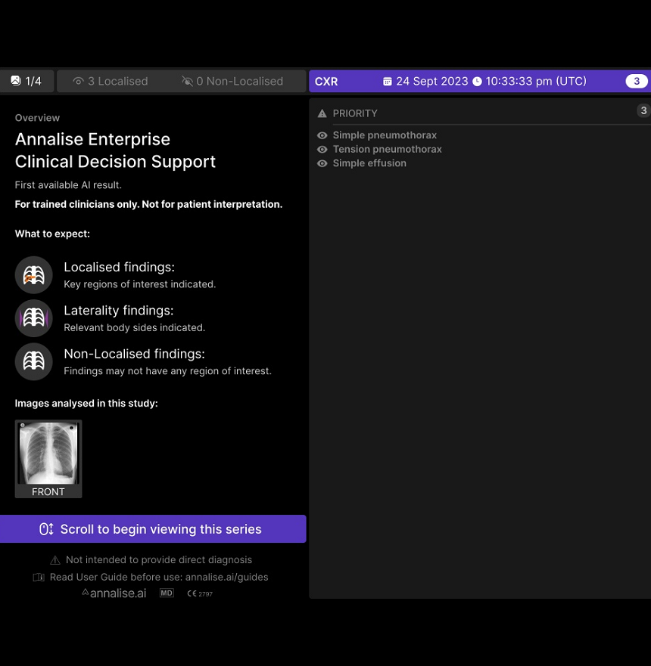
DICOM Secondary Capture examples
Image examples for Yorkshire Imaging Collaborative
Product release v3.6

Slide 2
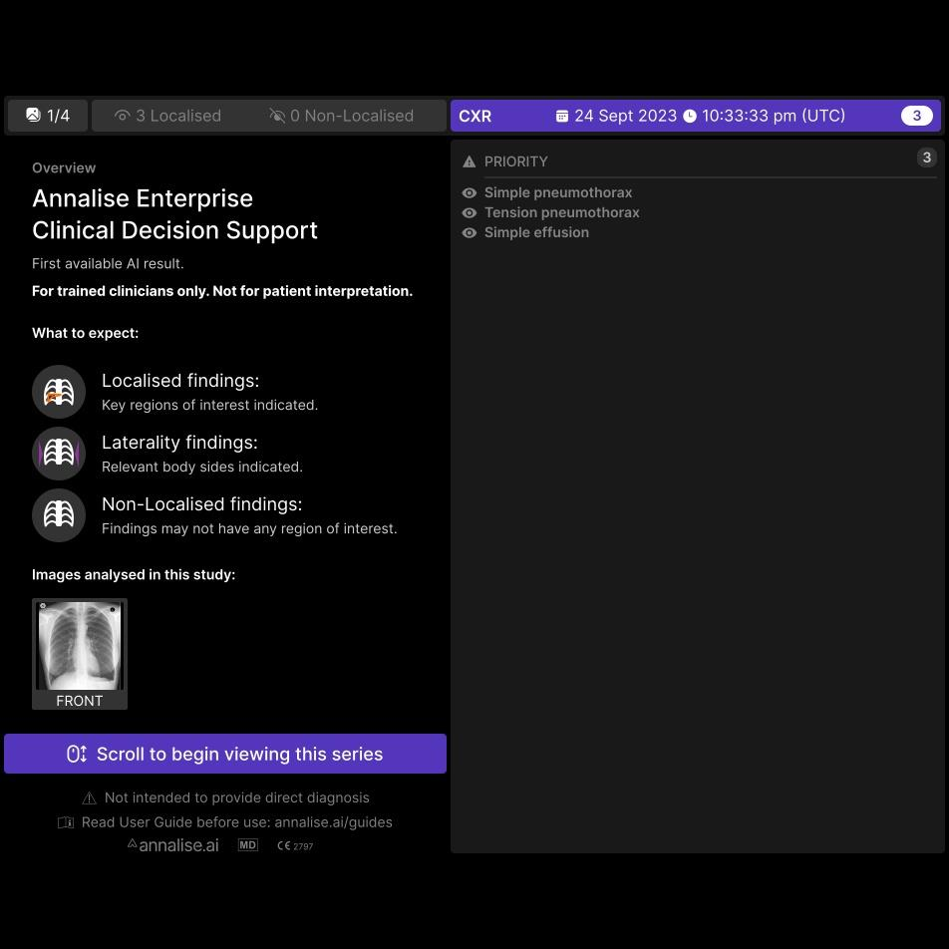
Example 1a, Overview and Localisation
AI may find multiple pathologies – they will be listed here and can be viewed as separate secondary capture images
Scroll through the images using the mouse wheel

Slide 3
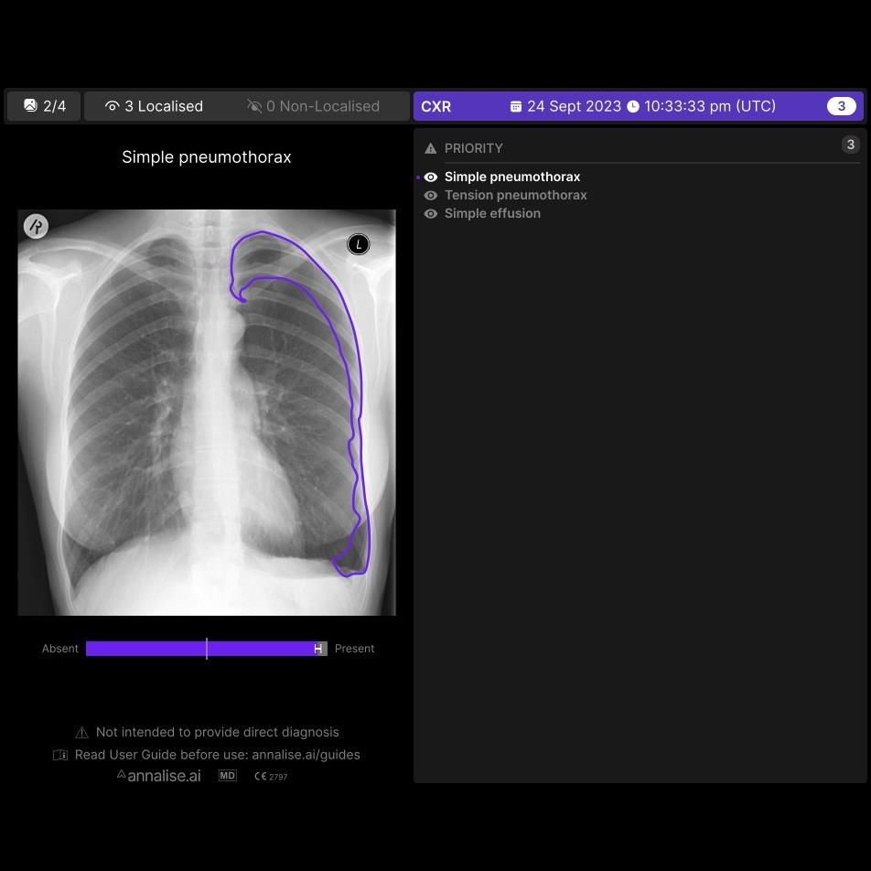
Example 1b, Overview and Localisation
Active finding highlighted
Localisation – on many findings.
Area that generated prediction
Confidence bar: provides a visual indication of the likelihood that a particular finding is present.
This is a high likelihood, with small error bars

Slide 4
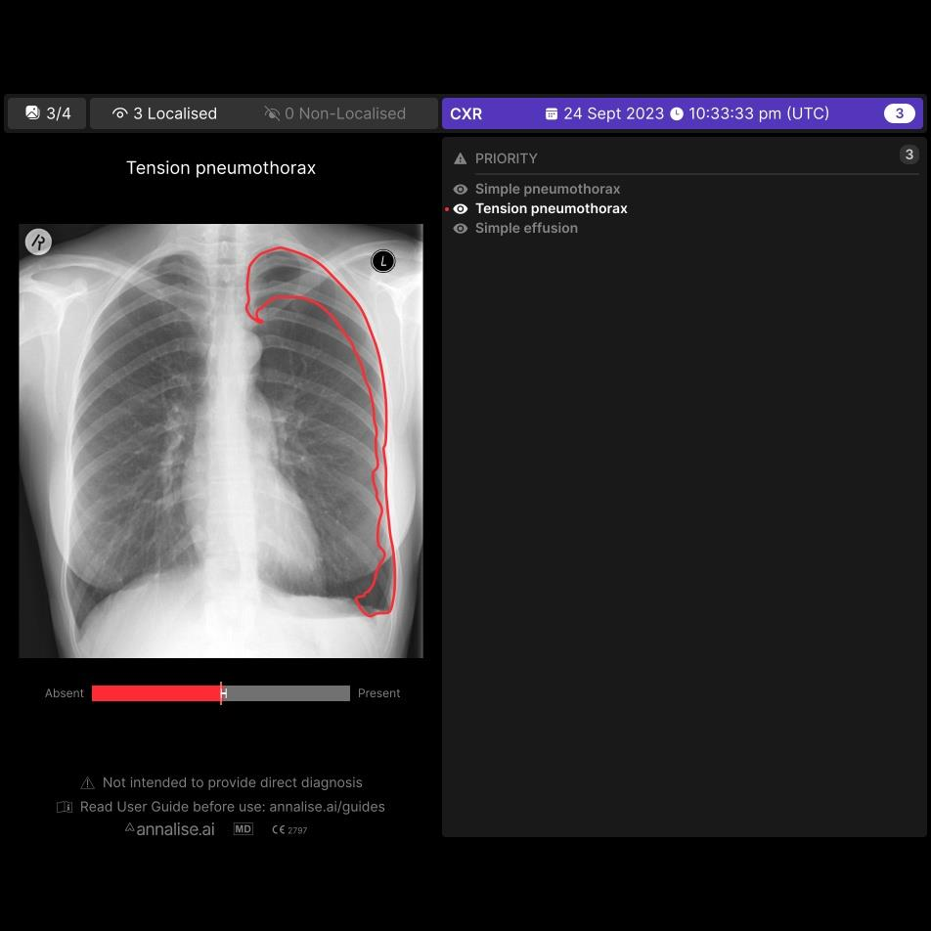
Example 1c, Overview and Localisation
Active finding highlighted
Colours have no particular meaning – used to distinguish each finding from adjacent images
Confidence threshold. Below this, the AI model is no longer confident that a finding is present. This finding has a lower confidence than the previous.

Slide 5
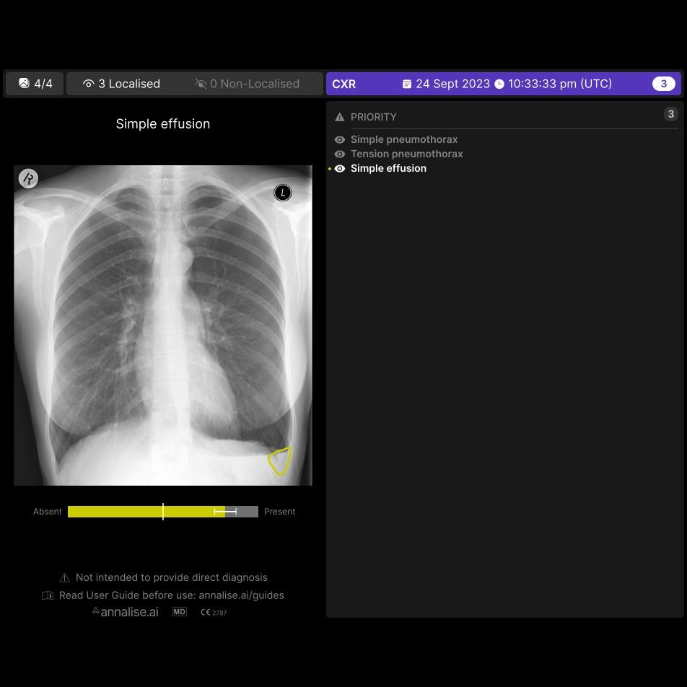
Example 1d, Overview and Localisation
Active finding highlighted
Localisation shown
95% confidence interval, indicating the probability of the AI model reporting a false positive.

Slide 6
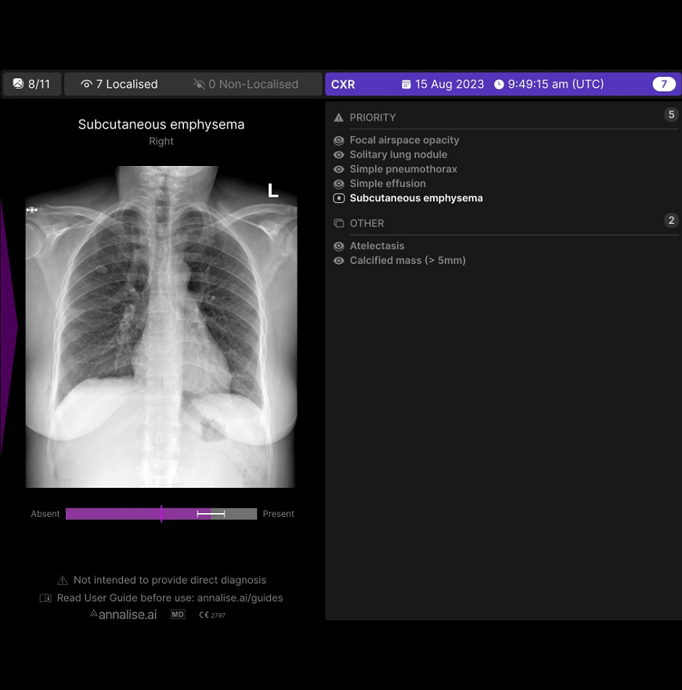
Example 2a, Laterality Marker
Laterality marker (purple triangle), here showing subcutaneous emphysema - right

Slide 7
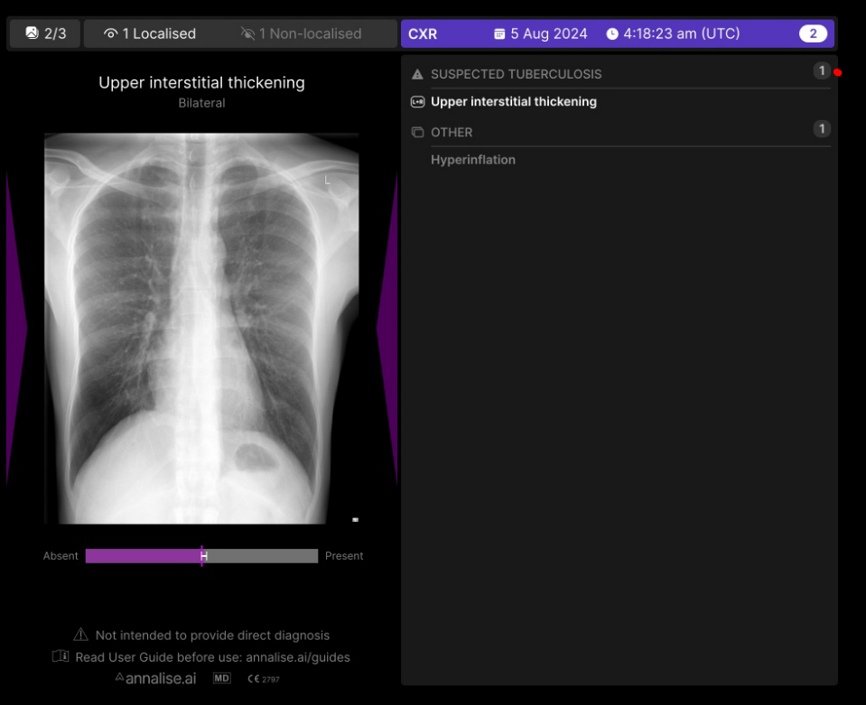
Example 2b, Laterality Marker
Laterality markers (purple triangle), here showing interstitial thickening - bilateral
CONFIDENTIAL

Slide 8
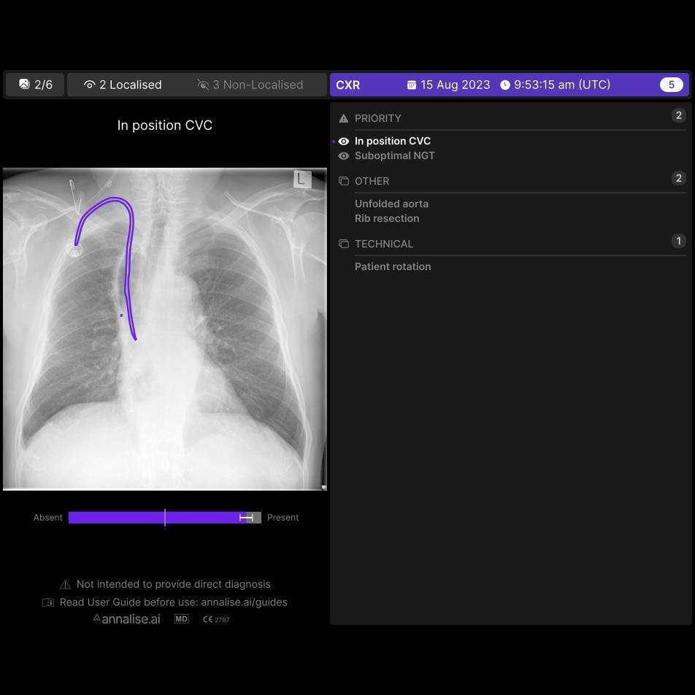
Example 3a, Lines & Tubes
Lines and Tubes examples with localisation

Slide 9
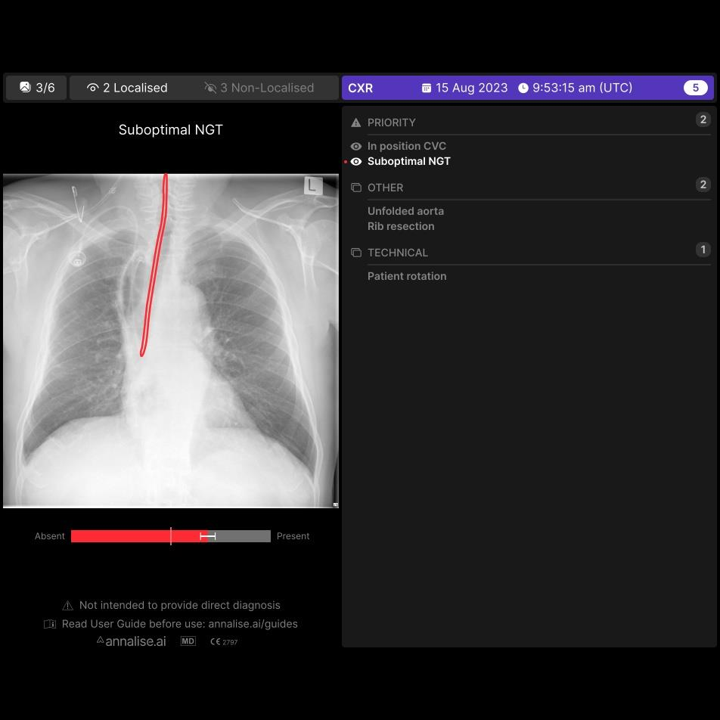
Example 3, Lines & Tubes
Example 3b, Lines & Tubes

Slide 10
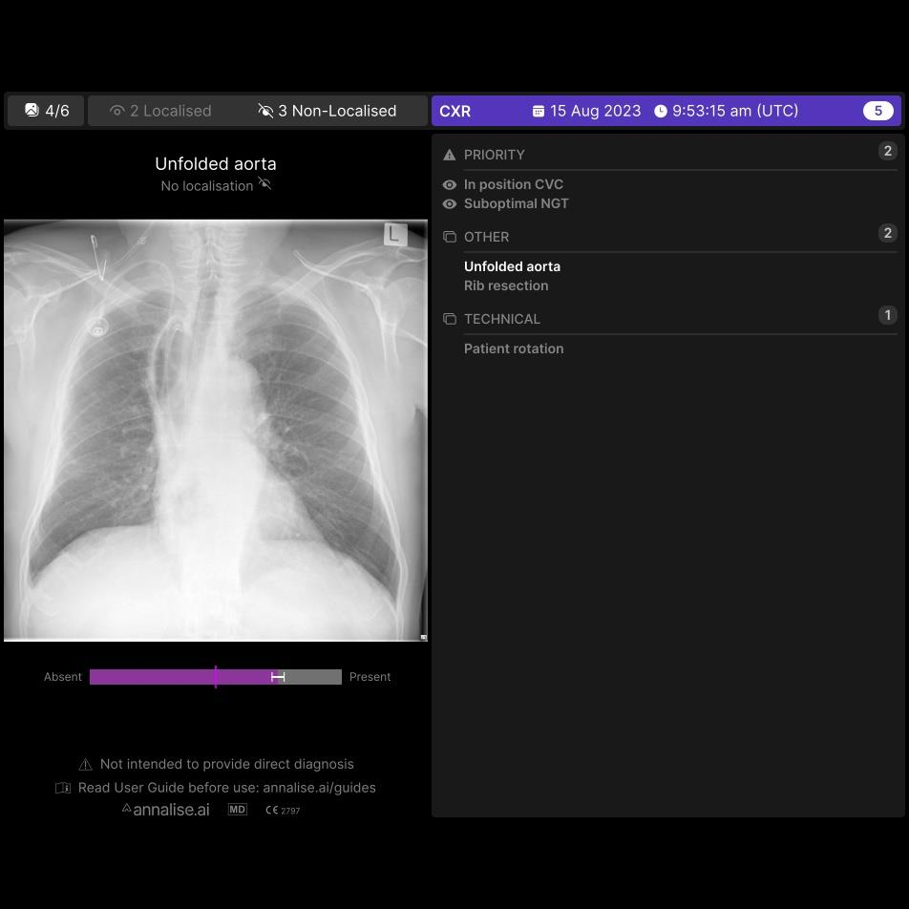
Example 3c, Lines & Tubes
Some findings do not need a localisation

Slide 11
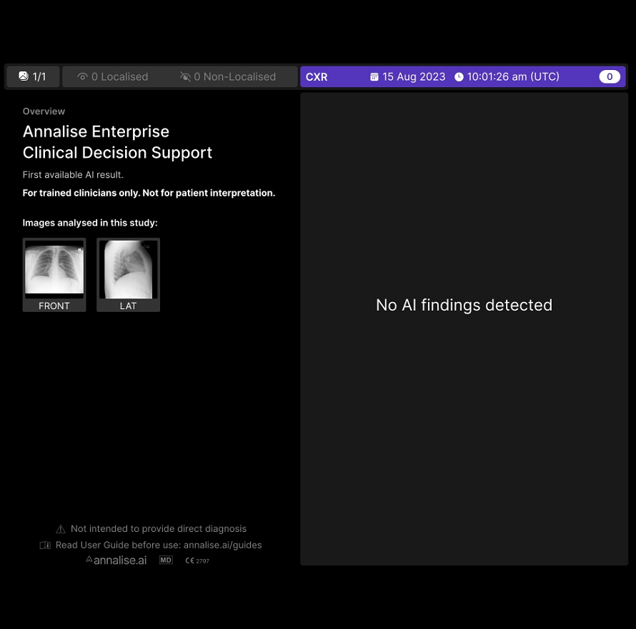
Example 4, no findings detected

